Slide 1
Network Simulator Tutorial
for Active Queue Management(AQM)
Computer Networks Lab (10B17CI671)

Slide 2
Network Simulation *
Motivation:
Learn fundamentals of evaluating network performance via simulation
Overview:
fundamentals of discrete event simulation
ns-2 simulation
Notes:
- The goal for us is to understand how networks work by simulating them.
- we’ll be looking at the following in particulat
- fundamentals of event simulation – what are events? How are they tracke?
- details of a particular popular network simulator other
- other examples are opnet, qualnet etc

Slide 3
What is simulation? *
system boundary
exogenous inputs
to system
(the environment)
system under study
(has deterministic rules
governing its behavior)
“real” life
observer
program boundary
psuedo random inputs
to system
(models environment)
computer program
simulates deterministic
rules governing behavior
“simulated” life
observer
Notes:
We want to study the behaviour of system under a given set of external factors
- For Internet, our system is the way we have placed nodes, routers, our protocols running on them (HTTP, TCP) etc.
- Our “exogenous” behaviour” can be, for exampe – how users are using the system – for example growth of online streaming video with youtube.
- We want to model the system so that we can engineer better systems
- Its clear that simulation becomes harder as we have large systems and varied inputs. We should be able to distiguish between the important and the non-imp. Properties, so that we can observe the relevant ones

Slide 4
Why Simulation? *
real-system not available, is complex/costly or dangerous (eg: space simulations, flight simulations)
quickly evaluate design alternatives (eg: different system configurations)
evaluate complex functions for which closed form formulas or numerical techniques not available
Notes:
We should go ahead and observe the actual system if possible, but we can’t do so for a variety of reasons.
More importantly, Simulation can let you abstract out some of the complexity.
Simulation is repeatable – When studying flash crowds, its hard to create flash crowds again and again, but its possible to simulate them as many times as needed

Slide 5
Simulation: advantages/drawbacks*
advantages:
  sometimes cheaper
  find bugs (in design) in advance
  generality: over analytic/numerical techniques
  detail: can simulate system details at arbitrary level
drawbacks:
  caution: does model reflect reality
  large scale systems: lots of resources to simulate (especially accurately simulate)
  may be slow (computationally expensive – 1 min real time could be hours of simulated time)
  art: determining right level of model complexity
  statistical uncertainty in results
Notes:
Simulation lets you separate the design bugs from the implementation bugs (for example – a server farm - have not got enough provisioning) – estimate etc

Slide 6
What is NS2?
Network Simulator
A package of tools that simulates behavior of networks
  Create Network Topologies
  Log events that happen under any load
  Analyze events to understand the network behavior
Notes:
Read

Slide 7
Creating Topologies
5Mbps,
10ms
300Kbps,
100ms
n1
n5
n3
500Kbps,
50ms
n4
n2
n6
2Mbps,
20ms
300Kbps,
100ms
Notes:
NS2 lets us create topologies with different nodes, different types of links in betweeb them

Slide 8
Creating Topologies
Nodes
  Set properties like queue length, location
  Protocols, routing algorithms
Links
  Set types of link – Simplex, duplex, wireless, satellite
  Set bandwidth, latency etc.
Done through tcl Scripts

Slide 9
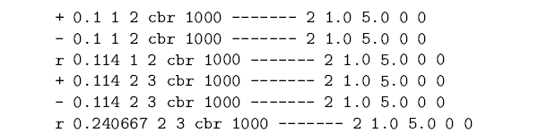
Observing Network Behavior
Observe behavior by tracing “events”
  Eg. packet received, packet drop etc.
Src Dst IP Address, Port
time
Notes:
The picture shows an example trace file:
+ shows that a packet entered the queue
- shows that a packet left the queue
r shows the packet was received
time, type of packet etc

Slide 10
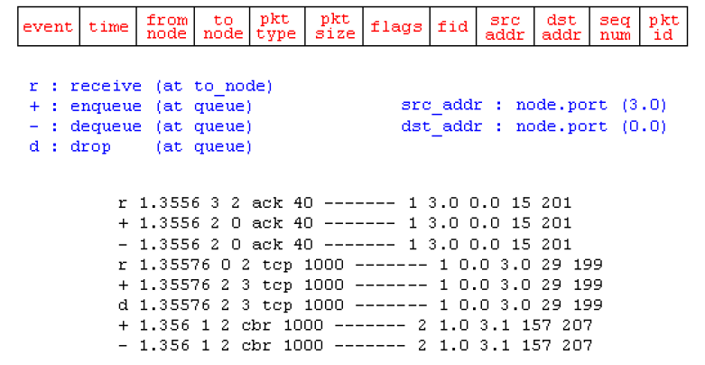
Trace File

Slide 11
Observing Network Behavior
NAM:
  Network Animator
  A visual aid showing how packets flow along the network
We’ll see a demo..
Notes:
Apart from having a trace file, it comes with a Network animator tool that allows visualization of nodes (much like the diagrams that we see in text books)

Slide 12
Basics of using NS2
Define Network topology, load, output files in Tcl Script
To run,
  $ ns simple_network.tcl
Internally, NS2 instantiates C++ classes based on the tcl scripts
Output is in form of trace files
Notes:
Read

Slide 13
A simple Example – Creating the topology
Bandwidth:1Mbps
Latency: 10ms
n1
n2
Notes:
So lets start by creating a topology is NS2, we’re just defining stuff, no packets are going through yet

Slide 14
Creating the topology
#create a new simulator object
set ns [new Simulator]
#open the nam trace file
set nf [open out.nam w]
$ns namtrace-all $nf
#define a 'finish' procedure
proc finish {} {
global ns nf
$ns flush-trace
#close the trace file
close $nf
#execute nam on the trace file
exec nam out.nam &
exit 0
}
Notes:
set ns [new Simulator]: generates an NS simulator object instance, and assigns it to variable ns (italics is used for variables and values in this section). What this line does is the following:
Create a scheduler (default is calendar scheduler)
The "Simulator" object has member functions that do the following:
Create compound objects such as nodes and links (described later)
Connect network component objects created (ex. attach-agent)
Set network component parameters (mostly for compound objects)
Create connections between agents (ex. make connection between a "tcp" and "sink")

Slide 15
Creating the topology (Contd)
#create two nodes
set n0 [$ns node]
set n1 [$ns node]
#create a duplex link between the nodes
$ns duplex-link $n0 $n1 1Mb 10ms DropTail
Notes:
set n0 [$ns node]: The member function node creates a node. A node in NS is compound object made of address and port classifiers (described in a later section). Users can create a node by separately creating an address and a port classifier objects and connecting them together. However, this member function of Simulator object makes the job easier.
$ns duplex-link node1 node2 bandwidth delay queue-type: creates two simplex links of specified bandwidth and delay, and connects the two specified nodes. In NS, the output queue of a node is implemented as a part of a link, therefore users should specify the queue-type when creating links. In the above simulation script, DropTail queue is used. If the reader wants to use a RED queue, simply replace the word DropTail with RED.

Slide 16
Demo

Slide 17
Adding traffic
n1
1Mbps,10ms
n2
udp
null
cbr
node
agent
Packet Size: 500 bytes
rate: 800Kbps
source
link
cbr traffic
0.5
4.5
5.0
time
0.0
Notes:
We are going to extend the example now: we are going to attach a udp agent to n1 and a sink at n2. (agents are abstractions – of “sockets” that are present in unix)
We are going to use udp to send constant bit-rate traffic – what this means is – that the rate is constant and packet size is constant (we will set these parameters)

Slide 18
Putting it together..
#create a udp agent and attach it to node n0
set udp0 [new Agent/UDP]
$ns attach-agent $n0 $udp0
#Create a CBR traffic source and attach it to udp0
set cbr0 [new Application/Traffic/CBR]
$cbr0 set packetSize_ 500
$cbr0 set interval_ 0.005
$cbr0 attach-agent $udp0
#create a Null agent(a traffic sink) and attach it to node n1
set null0 [new Agent/Null]
$ns attach-agent $n1 $null0
#Connect the traffic source to the sink
$ns connect $udp0 $null0
#Schedule events for CBR traffic
$ns at 0.5 "$cbr0 start"
$ns at 4.5 "$cbr0 stop"
#call the finish procedure after 5 secs of simulated time
$ns at 5.0 "finish"
#run the simulation
$ns run
Notes:
$ns attach-agent node agent: The attach-agent member function attaches an agent object created to a node object. Actually, what this function does is call the attach member function of specified node, which attaches the given agent to itself. Therefore, a user can do the same thing by, for example, $n0 attach $tcp. Similarly, each agent object has a member function attach-agent that attaches a traffic source object to itself.
$ns connect agent1 agent2: After two agents that will communicate with each other are created, the next thing is to establish a logical network connection between them. This line establishes a network connection by setting the destination address to each others' network and port address pair.

Slide 19
Demo

Slide 20
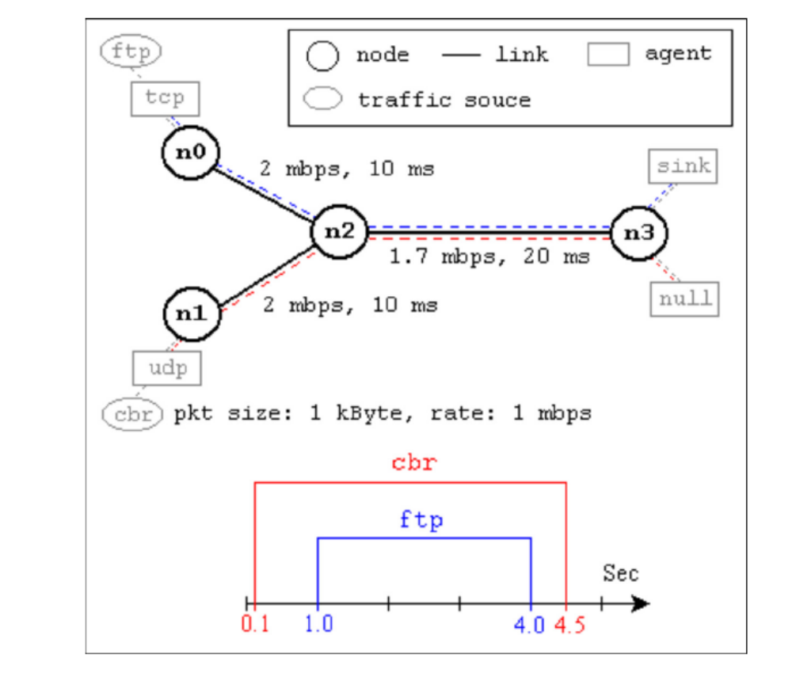
A second Scenario * (from NS by Example)
Taken from NS by Example by Jae Chung
and
Mark Claypool

Slide 21
A second Example (From NS by Example)
#Create a simulator object
set ns [new Simulator]
#Define different colors for data flows (for NAM)
$ns color 1 Blue
$ns color 2 Red
#Open the NAM trace file
set nf [open out.nam w]
$ns namtrace-all $nf
#Define a 'finish' procedure
proc finish {} {
global ns nf
$ns flush-trace
#Close the NAM trace file
close $nf
#Execute NAM on the trace file
exec nam out.nam &
exit 0
}

Slide 22
A Second Scenario (Contd.)
#Create four nodes
set n0 [$ns node]
set n1 [$ns node]
set n2 [$ns node]
set n3 [$ns node]
#Create links between the nodes
$ns duplex-link $n0 $n2 2Mb 10ms DropTail
$ns duplex-link $n1 $n2 2Mb 10ms DropTail
$ns duplex-link $n2 $n3 1.7Mb 20ms DropTail
#Set Queue Size of link (n2-n3) to 10
$ns queue-limit $n2 $n3 10

Slide 23
A Second Scenario (Contd.)
#Give node position (for NAM)
$ns duplex-link-op $n0 $n2 orient right-down
$ns duplex-link-op $n1 $n2 orient right-up
$ns duplex-link-op $n2 $n3 orient right
#Monitor the queue for link (n2-n3). (for NAM)
$ns duplex-link-op $n2 $n3 queuePos 0.5
Notes:
$ns duplex-link-op node1 node2 ...: The next couple of lines are used for the NAM display. To see the effects of these lines, users can comment these lines out and try the simulation.

Slide 24
A Second Scenario (Contd.)
#Setup a TCP connection
set tcp [new Agent/TCP]
$tcp set class_ 2
$ns attach-agent $n0 $tcp
set sink [new Agent/TCPSink]
$ns attach-agent $n3 $sink
$ns connect $tcp $sink
$tcp set fid_ 1
#Setup a FTP over TCP connection
set ftp [new Application/FTP]
$ftp attach-agent $tcp
$ftp set type_ FTP
To create agents or traffic sources, we need to know the class names these objects (Agent/TCP, Agent/TCPSink, Application/FTP and so on).
This information can be found in the NS documentation.
But one shortcut is to look at the "ns-2/tcl/libs/ns-default.tcl" file.
Notes:
et tcp [new Agent/TCP]: This line shows how to create a TCP agent. But in general, users can create any agent or traffic sources in this way. Agents and traffic sources are in fact basic objects (not compound objects), mostly implemented in C++ and linked to OTcl. Therefore, there are no specific Simulator object member functions that create these object instances. To create agents or traffic sources, a user should know the class names these objects (Agent/TCP, Agnet/TCPSink, Application/FTP and so on). This information can be found in the NS documentation or partly in this documentation. But one shortcut is to look at the "ns-2/tcl/libs/ns-default.tcl" file. This file contains the default configurable parameter value settings for available network objects. Therefore, it works as a good indicator of what kind of network objects are available in NS and what are the configurable parameters.
$ns attach-agent node agent: The attach-agent member function attaches an agent object created to a node object. Actually, what this function does is call the attach member function of specified node, which attaches the given agent to itself. Therefore, a user can do the same thing by, for example, $n0 attach $tcp. Similarly, each agent object has a member function attach-agent that attaches a traffic source object to itself.
$ns connect agent1 agent2: After two agents that will communicate with each other are created, the next thing is to establish a logical network connection between them. This line establishes a network connection by setting the destination address to each others' network and port address pair.

Slide 25
A Second Scenario (Contd.)
#Setup a UDP connection
set udp [new Agent/UDP]
$ns attach-agent $n1 $udp
set null [new Agent/Null]
$ns attach-agent $n3 $null
$ns connect $udp $null
$udp set fid_ 2
#Setup a CBR over UDP connection
set cbr [new Application/Traffic/CBR]
$cbr attach-agent $udp
$cbr set type_ CBR
$cbr set packet_size_ 1000
$cbr set rate_ 1mb
$cbr set random_ false

Slide 26
A Second Scenario (Contd.)
#Schedule events for the CBR and FTP agents
$ns at 0.1 "$cbr start"
$ns at 1.0 "$ftp start"
$ns at 4.0 "$ftp stop"
$ns at 4.5 "$cbr stop"
#Detach tcp and sink agents (not really necessary)
$ns at 4.5 "$ns detach-agent $n0 $tcp ; $ns detach-agent $n3 $sink"
#Call the finish procedure after 5 seconds of simulation time
$ns at 5.0 "finish"
#Print CBR packet size and interval
puts "CBR packet size = [$cbr set packet_size_]"
puts "CBR interval = [$cbr set interval_]"
#Run the simulation
$ns run

Slide 27
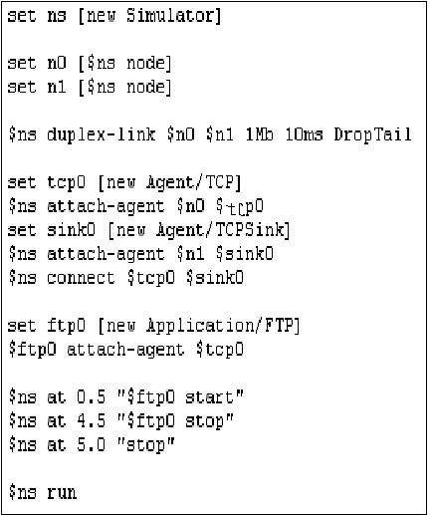
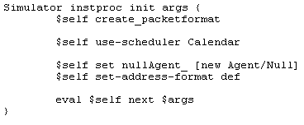
Explanation of Code Execution(I)
Run your program → % ns Simple.tcl
Simple.tcl

Slide 28
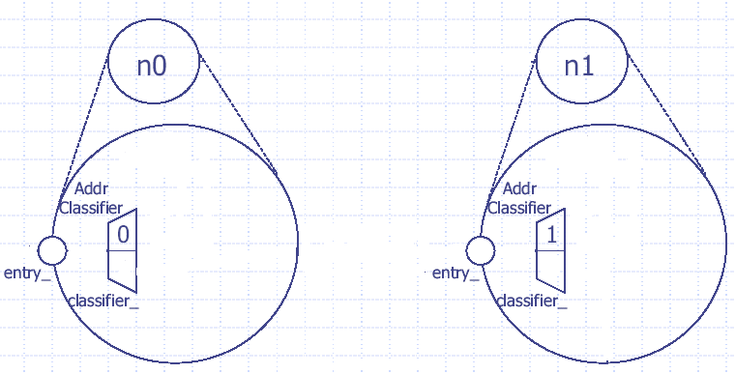
Explanation of Code Execution(II)

Slide 29
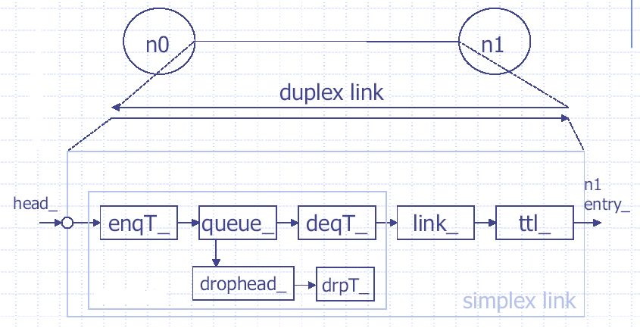
Explanation of Code Execution(III)

Slide 30
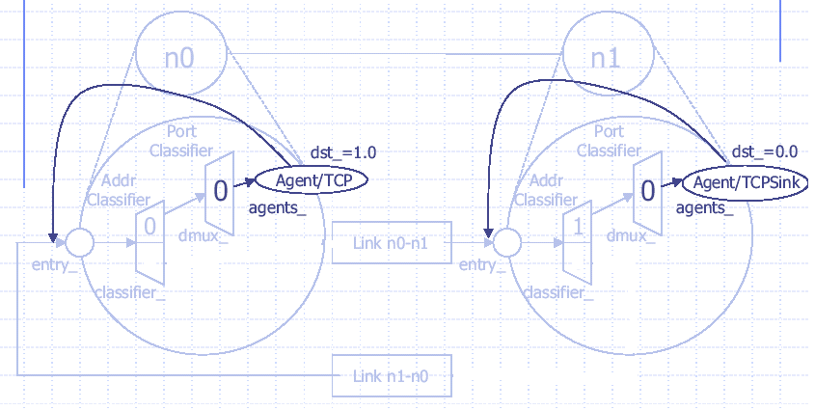
Explanation of Code Execution(IV)

Slide 31
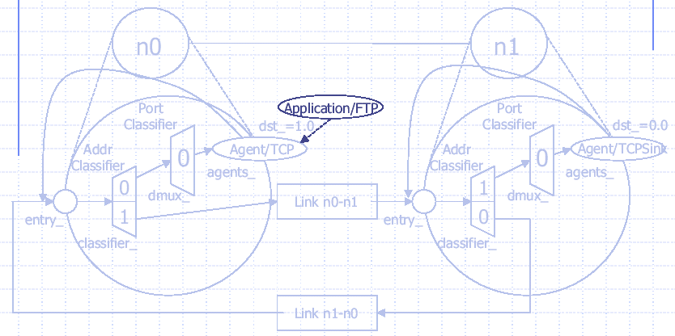
Explanation of Code Execution(V)

Slide 32
Thank You

